Slide 1

Native iOS & Android Development with Xamarin
Notes:
Welcome, today we are going to talk about Smart app with Xamarin and Azure! We are going to touch the Cognitive service api’s and we’ll see the power that they hold. But before we start.

Slide 2

Who is this guy?
Maurits van Beusekom
Twitter: @mvanbeusekom
E-mail: maurits@vnbskm.nl
github.com/mvanbeusekom

Slide 3

Progress is teamwork

Slide 4
Agenda
Architecting Mobile Apps
Building User Interface
Let’s Build an App (live demo)
Why choose for Xamarin
Development Experience
*Requires Visual Studio Enterprise

Slide 5
Architecting Mobile Apps
Notes:
So we know what we want how do we get there? Let’s talk about the state of mobile development.

Slide 6

Xamarin’s Unique Approach
iOS C# UI
Android C# UI
Windows C# UI
Shared C# Mobile
Shared C# codebase • 100% native API access • High performance

Slide 7
Windows APIs
Microsoft.Phone
Microsoft.Networking
Windows.Storage
Windows.Foundation
Microsoft.Devices
System.Net
System
System.IO
System.Linq
System.Xml
System.Data
System.Windows
System.Numerics
System.Core
System.ServiceModel
C#

Slide 8
iOS – 100% API Coverage
MapKit
UIKit
iBeacon
CoreGraphics
CoreMotion
System.Net
System
System.IO
System.Linq
System.Xml
System.Data
System.Windows
System.Numerics
System.Core
System.ServiceModel
C#

Slide 9
Android – 100% API Coverage
Text-to-speech
ActionBar
Printing Framework
Renderscript
NFC
System.Net
System
System.IO
System.Linq
System.Xml
System.Data
System.Windows
System.Numerics
System.Core
System.ServiceModel
C#

Slide 10

Platform Specific Code
UI+APIs
UI + APIs
UI + APIs
Battery
GPS
Lights
Notifications
Settings
Text To Speech
Battery
GPS
Lights
Notifications
Settings
Text To Speech
Battery
GPS
Lights
Notifications
Settings
Text To Speech
What if we didn’t have to write this code?
What if we could access it from shared code?

Slide 11
Speak(“Hello World”);
AVSpeechSynthesizer
TextToSpeech
SpeechSynthesizer

Slide 12
Plugins for Xamarin & Windows
Xamarin.com/plugins
Common API

Slide 13
Building User Interfaces
Notes:
So we know what we want how do we get there? Let’s talk about the state of mobile development.

Slide 14




Traditional UI approach
iOS C#
Android C#
Windows C#
Shared C# Logic
3 Native User Interfaces
Shared App Logic

Slide 15
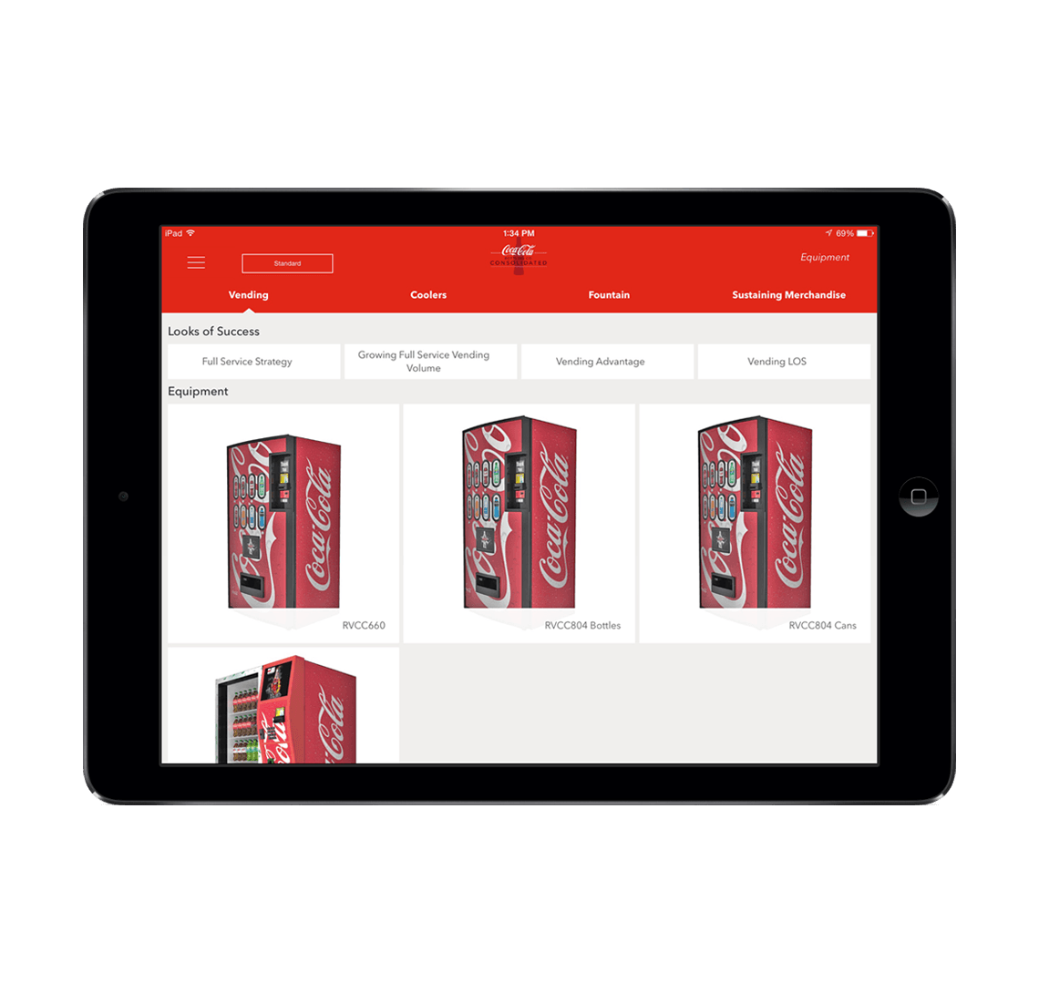
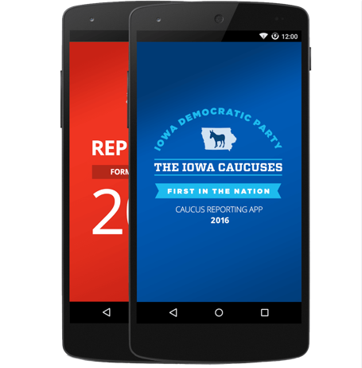
Xamarin.Forms approach
Shared UI Code
Shared C# Logic
Shared User Interface
Shared App Logic

Slide 16
UrhoSharp
CocosSharp
Notes:
Many popular and powerful game engines already leveraging C# are lifted by Mono runtime move to MIT license

Slide 17
Let’s Build an App

Slide 18
Why choose for Xamarin
Notes:
So we know what we want how do we get there? Let’s talk about the state of mobile development.

Slide 19
Code sharing stats
iCircuit
Touch Draw
Android
iOS
Mac
Windows

Slide 20
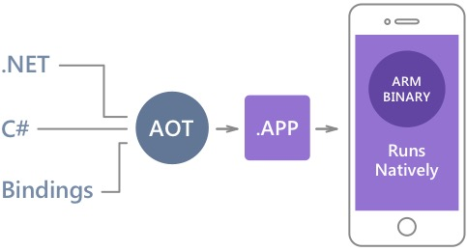
Native Performance
Xamarin.iOS does full Ahead Of Time (AOT) compilation to produce an ARM binary for Apple’s App Store.
Xamarin.Android takes advantage of Just In Time (JIT) compilation on the Android device.

Slide 21
✓Always Up-to-Date
Same-day support:
iOS 5
iOS 6
iOS 7
iOS 8
iOS 9
iOS 10
Full support for:
Apple Watch
Android Wear
Amazon Fire TV
Google Glass
and much more

Slide 22
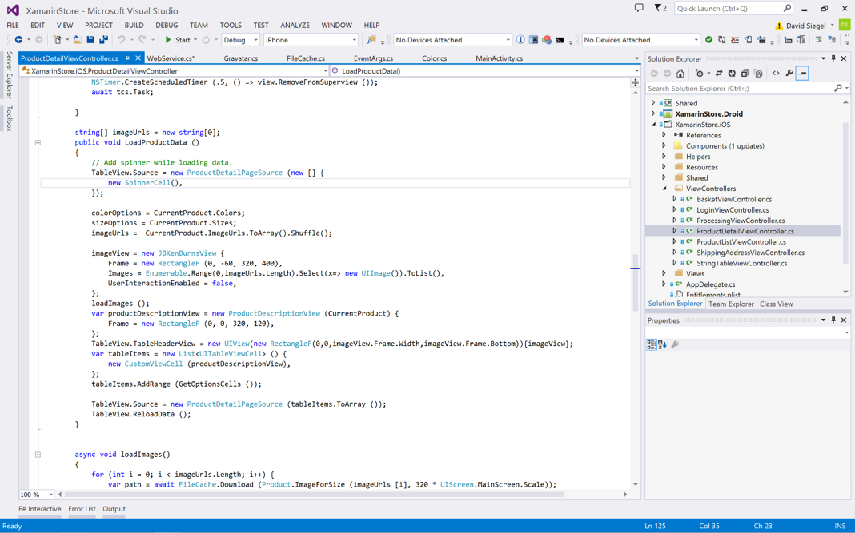
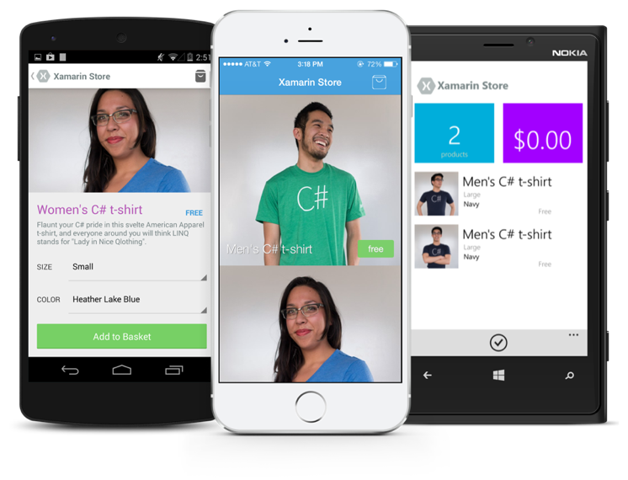
Anything you can do in Objective-C, Swift, or Java can be done in C# with Xamarin.
Notes:
Coming up next is bubbles

Slide 23
Development Experience

Slide 24
Xamarin is included in Visual Studio
Including Community Edition!

Slide 25
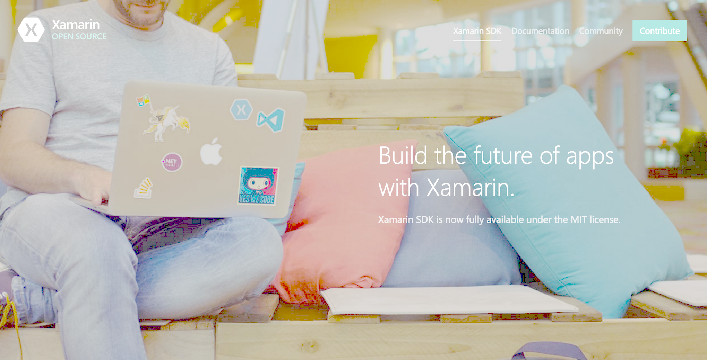
Open Source – open.xamarin.com

Slide 26
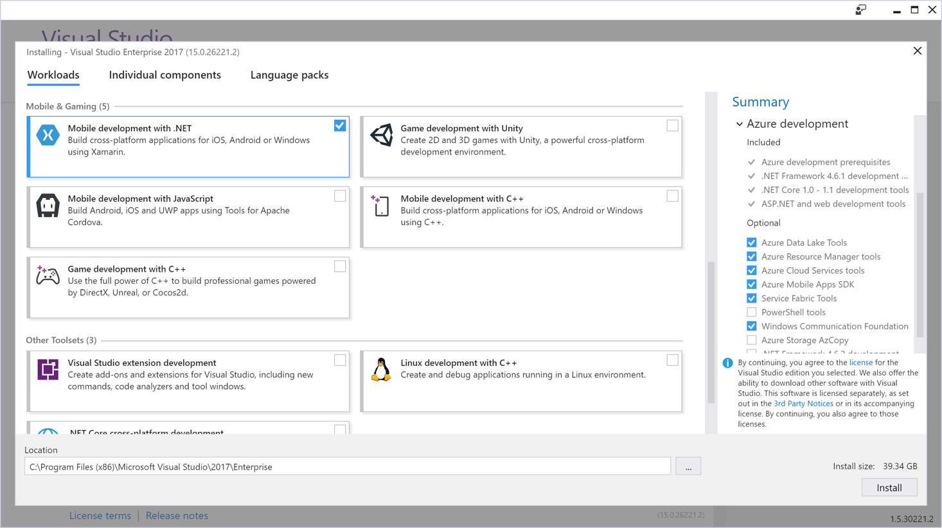
Visual Studio Integration
Xamarin.com/Download

Slide 27
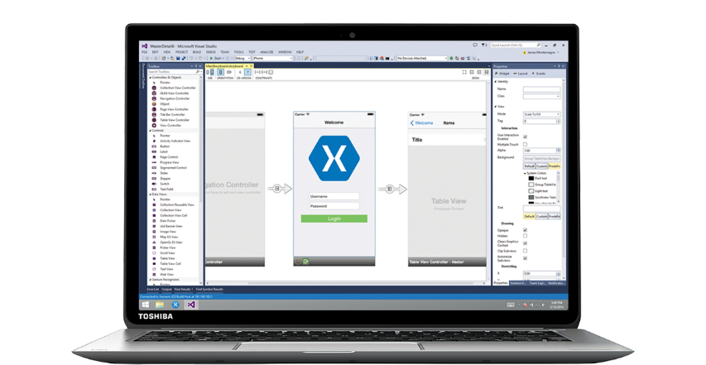
Xamarin for Visual Studio

Slide 28
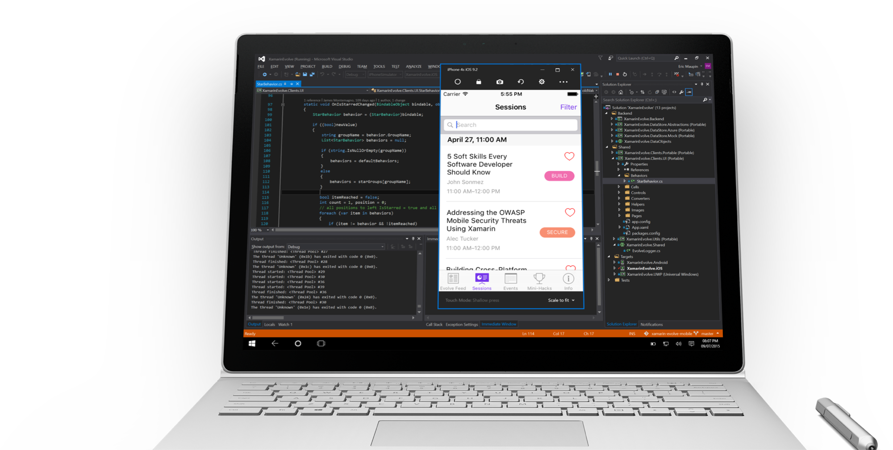
Visual Studio iOS Simulator Remoting
Multi-Touch Enabled
Pressure Sensitive
Super Fast
Rotate, screenshots, location changes
Never leave VS
*Requires Visual Studio Enterprise

Slide 29

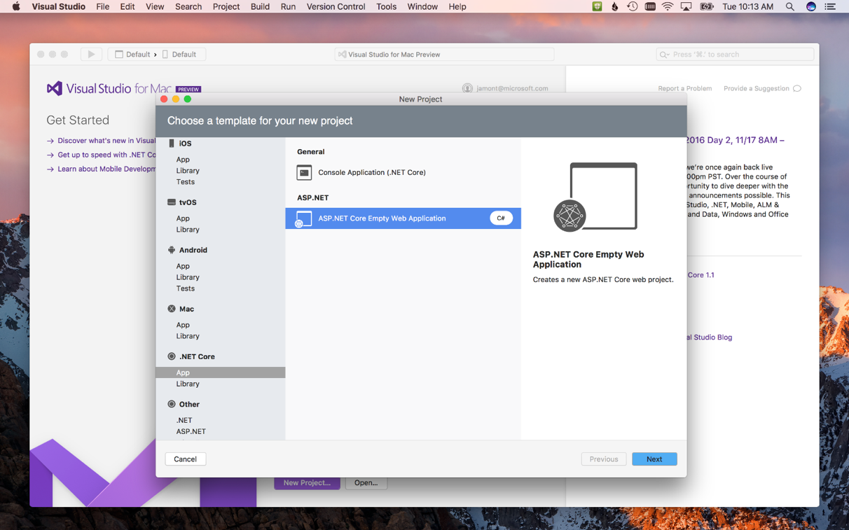
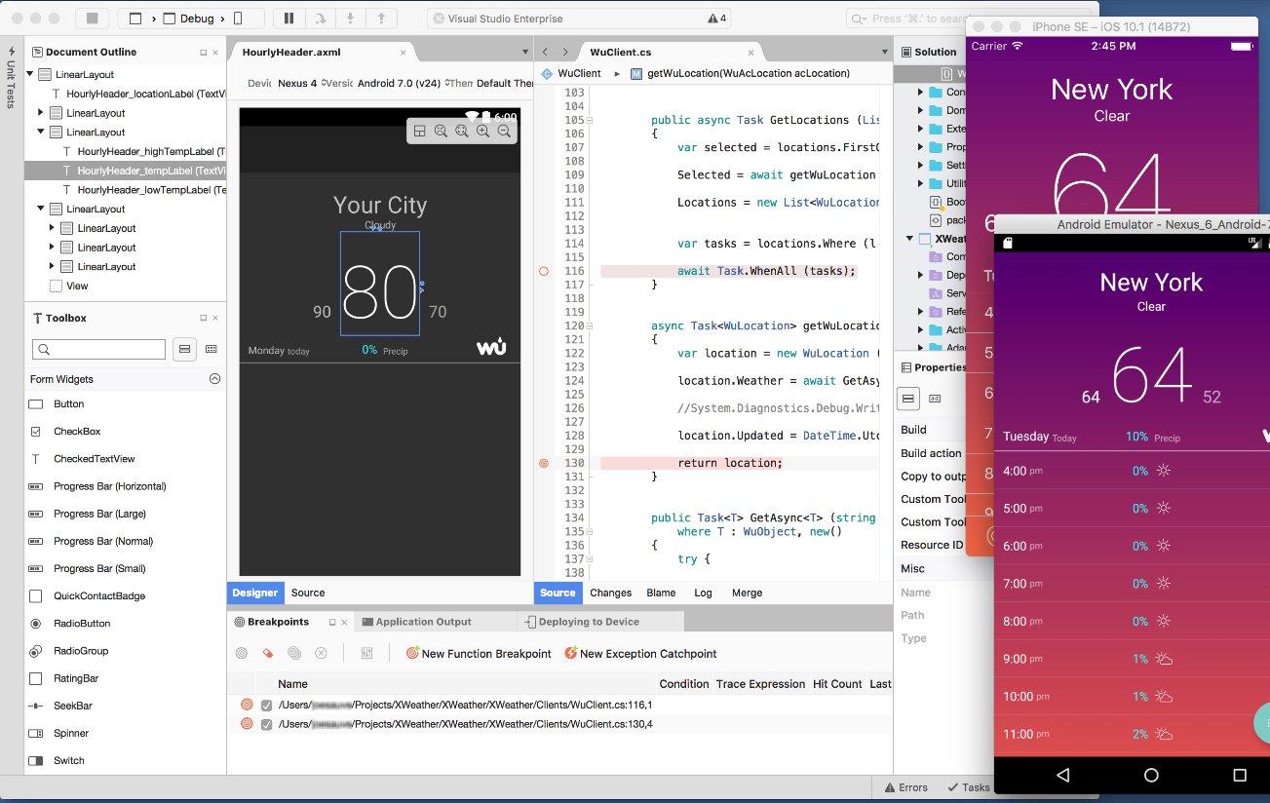
Visual Studio for Mac
iOS, Android, & macOS
.NET development
.NET Core & ASP.NET Core
Tools for Azure
Unity Game Development
Azure Functions
IoT
Docker

Slide 30
Questions
Xamarin
Github Xamarin: https://open.xamarin.com
Slack: https://xamarinchat.herokuapp.com/
Xablu:
Github: https://github.com/Xablu
Training, Internship, graduation or a coffee m.jonker@xablu.com

